Slide 1
Van Route Calculator
Geusens Robbe and Lopez Raul

Slide 2
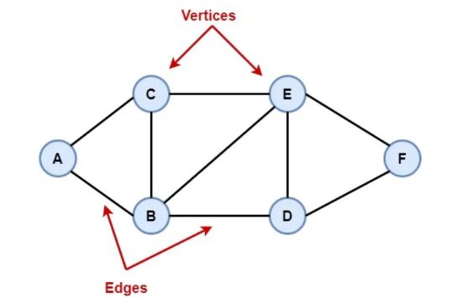
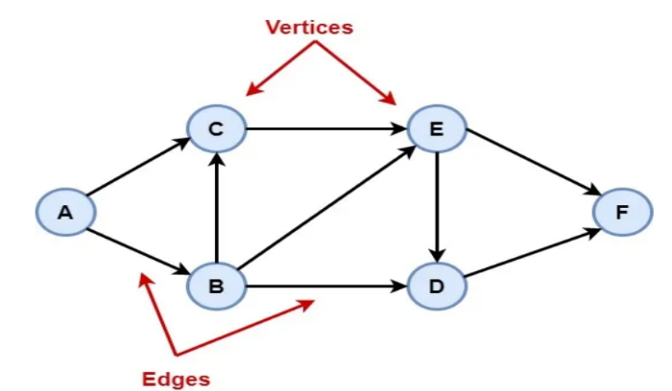
Graph data structures
Nodes and edges
Powerful modeling tool
Undirected and directed graphs
Weight as value

Slide 3
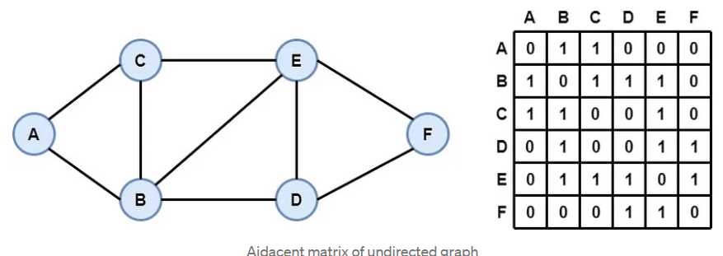
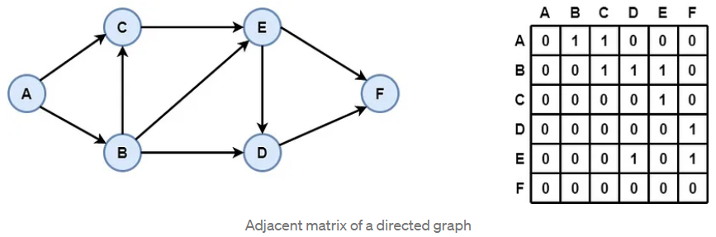
Graph data structures - Adjacent matrix
2D array
Value either 0 or 1
Edge is 1, no edge is 0

Slide 4
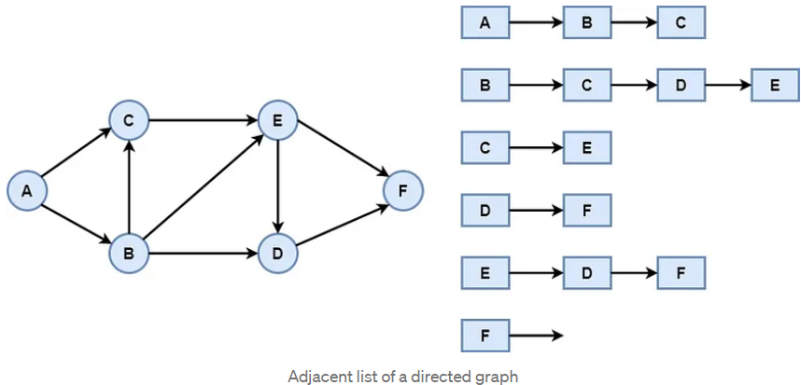
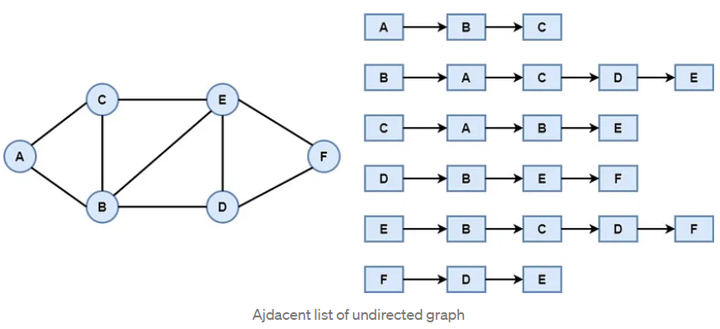
Graph data structure - Adjacent List
Array of linked lists
Each vertex had an index
Head of the list with all connected nodes

Slide 5

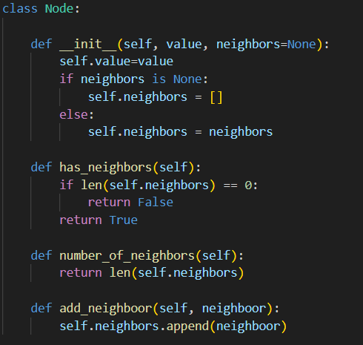
Python Implementation: Node class
Import libraries
Use of classes
Checking for neighbors
Creating new ones

Slide 6
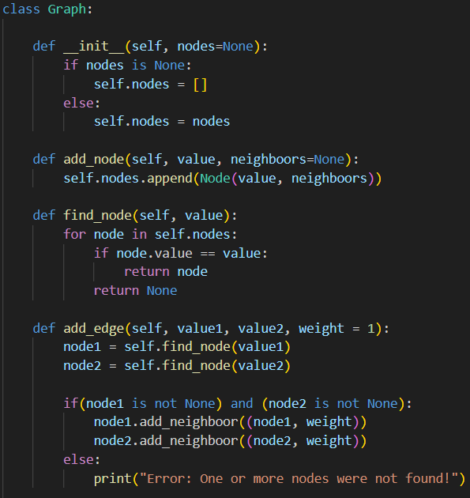
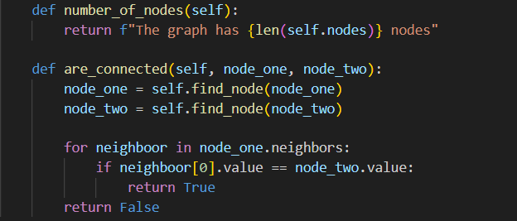
Python Implementation: Graph data structure class
Adding nodes
Finds nodes
Adding edges
Checking connection between nodes

Slide 7
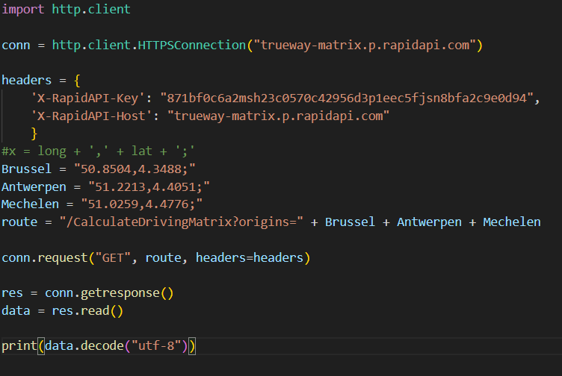
API
Used for calculation
Distance between cities
Coordinates

Slide 8
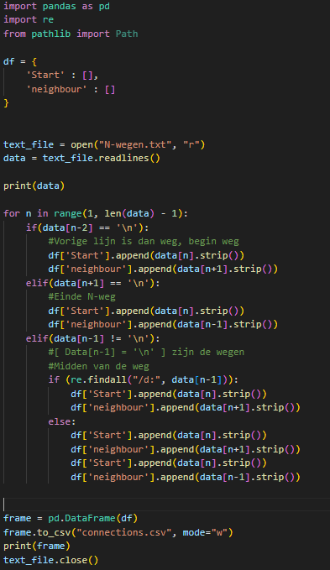
Read from file
All highways and national ways
Connection between cities
Dataframe for connections
Write connections to file

Slide 9
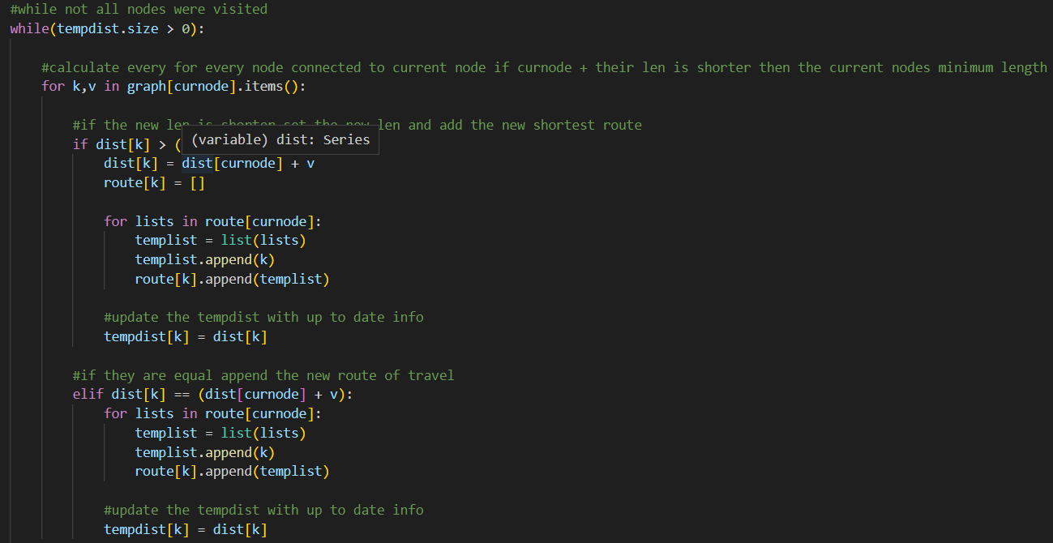
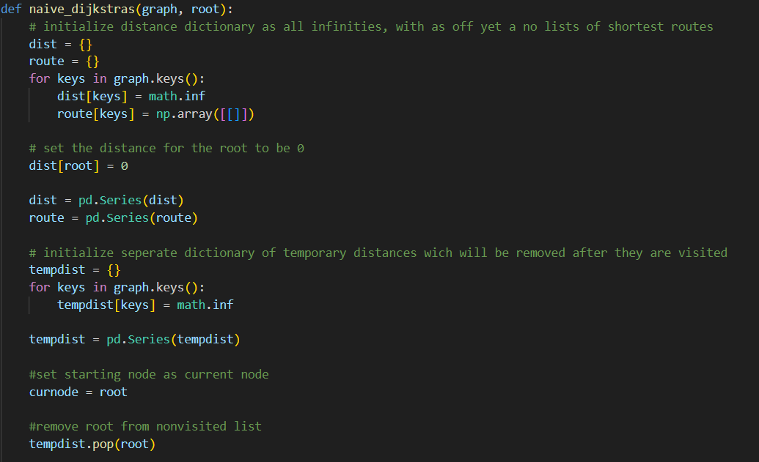
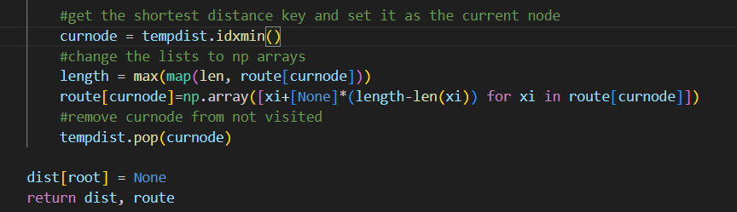
Dijkstra’s algorithm
Finds shortest path between nodes

